Slide 1

Ethereum Wallet

Slide 2
Wallet

Slide 3


Wallet
Mist
Parity

Slide 4

Wallet
Metamask

Slide 5

Wallet
MyEtherWallet

Slide 6
Address
Ethereum Yellow Paper

Slide 7
Address
1. Generation Private Key
2. Private Key -> Public Key
3. Public Key -> Address

Slide 8
HD Wallet
BIP 032 & 044

Slide 9
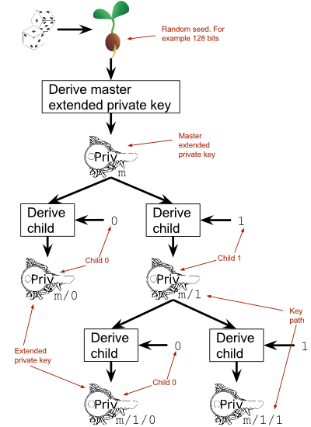
HD Wallet

Slide 10
Mnemonic
BIP 039

Slide 11
Mnemonic
1. Private Key * 1.1 (bits)
2. (Private Key * 1.1) / 11 (bits)
3. 2^11 bits -> word

